Slide 1
Software Design
Lecture 4

Slide 2
Last time
Architectural Patterns
Layers
Client-Server
Event-driven
Broker
Mediator
MVC (and variants)

Slide 3
Content
Architectural Patterns
Microkernel
Service-based
SOA
Microservices
Service Oriented Architecture Process
Case-Study
Service oriented patterns examples

Slide 4
References
Mark Richards, Software Architecture Patterns, O’Reilly, 2015 [SAP]
Mark Richards, Microservices vs. Service-Oriented Architecture O’Reilly, 2016
David Patterson, Armando Fox, Engineering Long-Lasting Software: An Agile Approach Using SaaS and Cloud Computing, Alpha Ed.[Patterson]
Taylor, R., Medvidovic, N., Dashofy, E., Software Architecture: Foundations, Theory, and Practice, 2010, Wiley [Taylor]
Ian Gorton. 2011. Essential Software Architecture. 2nd Edition, Springer-Verlag [Gorton]
Microsoft Application Architecture Guide, 2009 [MAAG]
Armando Fox, David Patterson, and Koushik Sen, SaaS Course Stanford, Spring 2012 [Fox]
Jacques Roy, SOA and Web Services, IBM
Mark Bailey, Principles of Service Oriented Architecture, 2008
Erl, Thomas. Service-Oriented Architecture: Analysis and Design for Services and Microservices. Pearson Education. 2016
Erl, Thomas. SOA Design Patterns, Prentice Hall, 2009.
http://soapatterns.org

Slide 5
Microkernel
Aka plug-in architecture
Natural pattern for implementing product-based applications
Allows to add new application features as plug-ins to the core application
2 types of components:
Core system
Plug-in modules

Slide 6
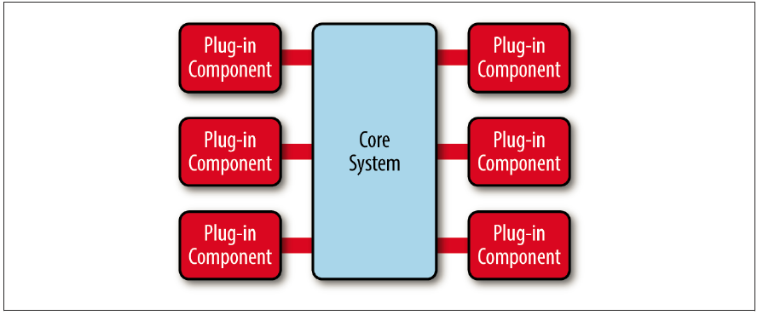
The core system - minimal functionality required to make the
system operational.
The plug-in modules - stand-alone, independent components that
contain specialized processing, additional features, and custom code.
Generally, plug-in modules should be independent of other plug-in modules.
The core system needs to know about which plug-in modules are available and how to get to them => a plug-in registry.
The registry contains information about each plug-in module (i.e. name, data contract, and remote access protocol details)
Plug-in modules can be connected to the core system via: OSGi (open service gateway initiative), messaging, web services, or even direct point-to-point binding

Slide 7
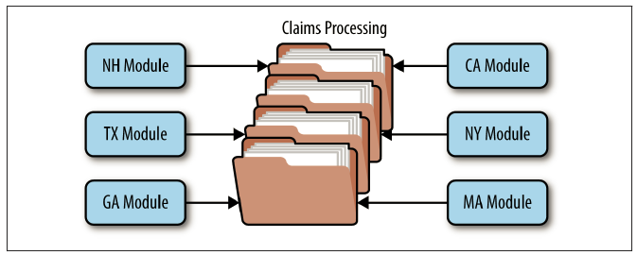
Considerations
Ex. Eclipse IDE
Ex. Insurance application
example
Non functional req. | Rating
Overall agility | High
Ease of deployment | High
Testability | High
Performance | High
Scalability | Low
Ease of development | Low

Slide 8
Service based architectures
“1.All teams will henceforth expose their data and functionality through service interfaces
2.Teams must communicate with each other through these interfaces
3.There will be no other form of interprocess communication allowed: no direct linking, no direct reads of another team's data store, no shared-memory model, no back-doors whatsoever. The only communication allowed is via service interface calls over the network.

Slide 9
4. It doesn't matter what [API protocol] technology you use.
5. Service interfaces, without exception, must be designed from the ground up to be externalizable. That is to say, the team must plan and design to be able to expose the interface to developers in the outside world. No exceptions.
6. Anyone who doesn't do this will be fired.
7. Thank you; have a nice day!”
Amazon CEO

Slide 10

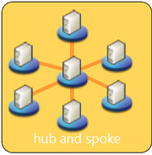
Application Centric
Business scope
Narrow Consumers Limited Business Processes
Finance
Integration
Architecture
bound to EAI vendor
Supply
Redundancy
Manufacturing
Distribution
Overlapped resources Overlapped providers
EAI ‘leverage’ application silos with the drawback of data and function redundancy.
Business functionality is duplicated in each application that requires it.

Slide 11
Service Centric
Business scope
Multiple Service Consumers Multiple Business Processes
Finance
Service
Service
Supply
Service Architecture
Service
Shared
Services
Service
Manufacturing
Distribution
Multiple Discrete Resources Multiple Service Providers
Service virtualizes how that capability is performed, and where and by whom the resources are provided, enabling multiple providers and consumers to participate together in shared business activities.
SOA structures the business and its systems as a set of capabilities that are offered
as Services, organized into a Service Architecture
source:TietoEnator AB, Kurts Bilder
Notes:
structures the business and its systems as a set of capabilities that are
<CLICK> offered as Services organized into a service architecture
and where the Service virtualizes how that capability is performed, and where and by whom the resources are provided,
enabling
<CLICK> multiple providers and consumers to participate together in shared business activities.

Slide 12
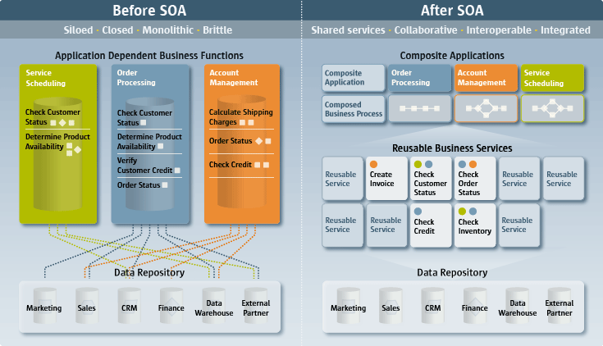
Before SOA – After SOA
source:IBM

Slide 13
Design principles [1]
Services are reusable
Business functionalities exposed as services are designed with the intention of reuse whenever and where they are required
Services share a formal contract
Services interact with each through a formal contract which is shared to exchange information and terms of usage
Services are loosely coupled
Services are designed as loosely coupled entities able to interact while maintaining their state of loose coupling.
Services abstract underlying logic
The business logic underpinning a service is kept hidden from the outside world. Only the service description and formal contract are visible for the potential consumers of a service

Slide 14
Design principles [2]
Services are composable
Services may composed of other services. Hence, a service’s logic should be represented at different levels of granularity and promotes reusability and the creation of abstraction layers.
Services are autonomous
A service should be independent of any other service
Services are stateless
A service shouldn’t required to maintain state information rather it should be designed to maximize statelessness
Services are discoverable
A service should be discoverable through its description, which can be understood by humans and service users. A service can be discovered by the use of a directory provider, or implementation mechanism or hard-coded address

Slide 15
Design Principles [3]
Services have a network-addressable interface
A service should be invoked from the same computer or remotely –through a local interface or Internet
Services are location transparent
A service should be discoverable without the knowledge of its real location. A requestor can dynamically discover the location of a service looking up a registry.
The core principles are autonomy, loose coupling, abstraction, formal contract

Slide 16
What is a Web Service? (W3C definition)
A Web service is a:
software system designed to support
interoperable machine-to-machine interaction over a network.
has an interface described in a machine-processable format (specifically WSDL).
Other systems interact with the Web service in a manner prescribed by its description using SOAP-messages, typically conveyed using HTTP with an XML serialization in conjunction with other Web-related standards.

Slide 17
What is a Web Service: A Simpler Definition
A Web Service is a standards-based way for an application to call a function over a network and to do it without having to know:
the location where the function will be executed,
the platform where the function will be run,
the programming language it is written in, or even
who built it.
Notes:
Simply put, Web Services is a way for one application to exchange data with another application using extensible industry standard protocols based on XML. Basically, it is yet another way for two applications to communicate with each other. Why are Web Services different and why do they hold so much promise where previous technologies such as CORBA and DCOM failed? The answer is very simple; where as previous technologies used specialized and proprietary protocols Web Services is based on open and extensible protocols based on XML lingua franca for open communications.
Because Web Services are build using extensible industry standards it provides application developers with:
Ability to conduct communication data exchange regardless of the location (same machine, another machine on an intranet, a service somewhere on internet)
Ability to use a service no matter what platform the service is run or what platform the consuming application is run
Ability to completely ignore details of the implementation of the service such as the programming language that was used or the underlying application technologies.
Web Services will succeed, one might say have already succeeded, where others have failed.
Web services are technologies that allow applications to communicate with each other in a platform- and programming language-independent manner. A Web service is a software interface that describes a collection of operations that can be accessed over the network through standardized XML messaging. It uses protocols based on the XML language to describe an operation to execute or data to exchange with another Web service. A group of Web services interacting together in this manner defines a particular Web service application in a Service-Oriented Architecture (SOA). While Web services allow dynamic features to combine multiple services into applications, you still have to build the services first. Programming languages in computer science are continually evolving. We began decades ago with the idea of a function in which you provide some parameters, it executes some operation on those parameters, and it returns a value based on its calculations. Eventually, this first concept evolved into the object where each object had not just a number of functions it can perform, but also its own private data variables, rather than relying on external system-wide data variables that previously made it more complex to develop applications. As applications began communicating with each other, the concept of defined universal interfaces for objects became important, allowing objects on other platforms to communicate even if they were written in other programming languages and ran on other operating systems.

Slide 18
Web Services - SOAP based
Discovery
Where is the service?
Description
What service does it offer?
How do I use it?
Messaging
Let’s communicate!
Discovery
UDDI
Description
WSDL
Messaging
SOAP

Slide 19
Standard is Key
WSDL is used to describe the function(s) that an application will be calling documenting in a standard way its entry points, parameters and output
XML is used to carry the values of parameters and the outputs of the function
SOAP is used as the messaging protocol that carries content (XML) over a network transport (typically HTTP)
HTTP is used as the network transport layer
Notes:
Four key specifications form the Web Services stack.
WSDL provides the description of the web service by specifying the collection of functions that a web service can perform, the inputs that these functions expect to receive and the type of output that a caller can expect to get back. Because WSDL is a standard, it can be interpreted by an application that needs to call the service automatically i.e. without a need for human intervention. There is no need to call the writer of the service, get a specification from him/her etc. Someone who wants to use the service simply needs to be able to get its WSDL.
The data that is carried between the caller of a web service (web service consumer) and the web service itself (web service provider) is encoded using XML. Because XML allows for standard data representation, both web service consumer and the web service provider do not have to know or care about either the platform that each is running on or the programming language or application framework that each is using. For example, a consumer written in C# can call a web service written in Java in exactly the same way as a web service written in C#. As a matter of fact, the consumer never knows how a web service he is consuming is implemented.
SOAP is a standard messaging protocol that is used to make a call to a web service and to bring the results back. SOAP is frequently described as an envelope which contains the XML payload.
HTTP is the most popular network transport for carrying SOAP messages for Web Services. It is popular because of its ability to traverse firewalls and because it is ubiquitous. Web Services allows for use of other protocols (e.g. MQ) but their use is quite rare.

Slide 20
Interaction
UDDI
Service1
WSDL
Register
Discover
SOAP request
Web Service
Service1
Application
SOAP response

Slide 21
WSDL: Web Service Description Language
WSDL (Web Services Description Language) is a public description of the interfaces offered by a web service.
Expressed in XML
Describes services as a set of endpoints
Document-oriented
Procedure-oriented
Notes:
WSDL is really at the very core of the Web Services architecture. It provides complete specification for the functionality exposed by a web service, all of the input and output formats and all other information required to communicate with a web service. It is expressed entirely in XML using a well known schema.
WSDL describes services as a set of endpoints. WSDL can describe the 2 styles of Web Services: document-oriented or procedure-oriented. WSDL allows for a description of each individual message and operation and then binding them to a specific protocol (e.g. HTTP) to create an endpoint. A collection of endpoints is what defines a web service.

Slide 22
WSDL Specification
XML grammar
<definitions>: root WSDL element
<types>: data types transmitted (starts with XML Schema specifications)
<message>: messages transmitted
<portType>: functions supported
<binding>: specifics of transmissions
<service>: how to access it
Notes:
The XML Schema built-in types include string, boolean, float, double, decimal, binary, integer, nonPositiveInteger, negativeInteger, long, int, short, byte, nonNegativeInteger, unsignedLong, unsignedInt, unsignedShort, unsignedByte, positiveInteger, date, time.

Slide 23
SOAP: A Description
Industry standard message format for sending and receiving data between a web services consumer and a web service provider
SOAP messages are XML documents which have an envelope and:
Header (optional): contains information about the message such as date/time it was sent or security information
Body: contains the message itself
Standard messaging protocol maintained by the W3C XML Protocol Working Group.
SOAP Message
SOAP Part
SOAP Envelope
SOAP Header
SOAP Body
Attachment Part
(optional)
Attachment Part
(optional)
SOAP used to stand for Simple Object Access Protocol
Notes:
The SOAP runtime you use provides the appropriate API to limit the complexity of communication

Slide 24
Give it a REST
REST: REpresentation State Transfer
Rest-ful: Follows the REST principles
Not strictly for web services
Term used loosely as a method of sending information over HTTP without using a messaging envelope

Slide 25
Representational State Transfer (REST)
Idea: Self-contained requests specify what resource to operate on and what to do to it [Roy Fielding’s PhD thesis, 2000]
Wikipedia: “a post hoc description of the features that made the Web successful”
A service (in the SOA sense) whose operations are like this is a RESTful service
Ideally, RESTful URIs name the operations

Slide 26
REST Principles
[RP1] The key abstraction of information is a resource, named by an URL. Any information that can be named can be a resource.
[RP2] The representation of a resource is a sequence of bytes, plus representation metadata to describe those bytes. The particular form of the representation can be negotiated between REST components.
[RP3] All interactions are context-free: each interaction contains all of the information necessary to understand the request, independent of any requests that may have preceded it (Stateless).

Slide 27
REST Principles (cont’d)
[RP4] Components perform only a small set of well-defined methods on a resource producing a representation to capture the current or intended state of that resource and transfer that representation between components. These methods are global to the specific architectural instantiation of REST; for instance, all resources exposed via HTTP are expected to support each operation identically (Uniform interface).

Slide 28
REST Principles (cont’d)
[RP5] Idempotent operations and representation metadata are encouraged in support of caching and representation reuse.
[RP6] The presence of intermediaries is promoted. Filtering or redirection intermediaries may also use both the metadata and the representations within requests or responses to augment, restrict, or modify requests and responses in a manner that is transparent to both the user agent and the origin server (Links between resources).

Slide 29
Resources
XML representation
<Person>
<ID>1</ID>
<Name>M Vaqqas</Name>
<Email>m.vaqqas@gmail.com</Email>
<Country>India</Country>
</Person>
JSON representation
{
"ID": "1",
"Name": "M Vaqqas",
"Email": "m.vaqqas@gmail.com",
"Country": "India"
}

Slide 30
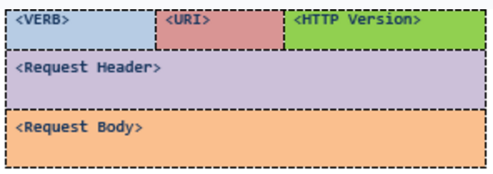
Messages – HTTP request
<VERB> is one of the HTTP methods like GET, PUT, POST, DELETE, OPTIONS, etc
<URI> is the URI of the resource on which the operation is going to be performed
<HTTP Version> is the version of HTTP
<Request Header> contains the metadata as a collection of key-value pairs of headers and their values. These settings contain information about the message and its sender like client type, the formats client supports, format type of the message body, cache settings for the response, and a lot more information.
<Request Body> is the actual message content. In a RESTful service, that's where the representations of resources sit in a message.

Slide 31
POST request example
POST http://MyService/Person/
Host: MyService
Content-Type: text/xml; charset=utf-8
Content-Length: 123
<?xml version="1.0" encoding="utf-8"?>
<Person>
<ID>1</ID>
<Name>M Vaqqas</Name>
<Email>m.vaqqas@gmail.com</Email>
<Country>India</Country>
</Person>

Slide 32
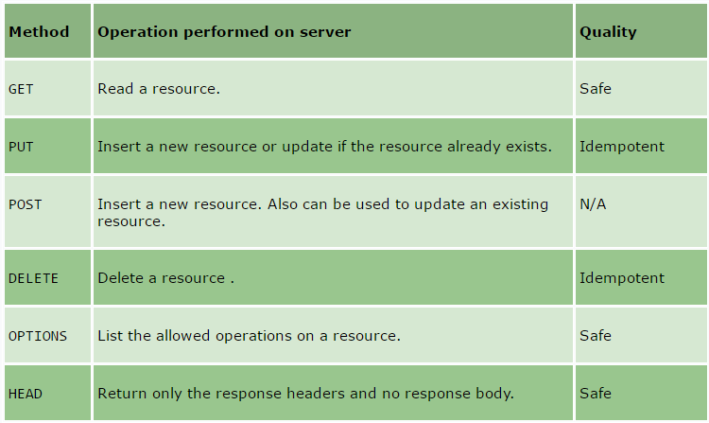
HTTP verbs – uniform interface

Slide 33
PUT vs. POST
PUT
Creates THE new resource with newResourceId as the identifier, under the /resources URI, or collection (i.e. Client defined URI).
PUT /resources/<newResourceId> HTTP/1.1
POST
Creates A new resource under the /resources URI, or collection. Usually the identifier is returned by the server.
POST /resources HTTP/1.1

Slide 34
Statelessness
does not maintain the application state for any client. A request cannot be dependent on a past request and a service treats each request independently.
Example:
Request1: GET http://MyService/Persons/1 HTTP/1.1
Request2: GET http://MyService/Persons/2 HTTP/1.1

Slide 35
SOAP vs. REST
SOAP
SOAP is still offered by some very prominent tech companies for their APIs (Salesforce, Paypal, Docusign).
SOAP is good for applications that require formal contracts between the API and consumer, since it can enforce the use of formal contracts by using WSDL
Additionally, SOAP has built in WS-Reliable messaging to increase security in asynchronous execution and processing.
SOAP has built-in stateful operations. SOAP is designed support conversational state management.
Provides support for WS_AtomicTransaction and WS_Security, SOAP can benefit developers when there is a high need for transactional reliability.

Slide 36
SOAP
Language, platform, and transport independent (REST requires use of HTTP)
Works well in distributed enterprise environments (REST assumes direct point-to-point communication)
Standardized
Provides significant pre-build extensibility in the form of the WS* standards (I.e. WS-Addressing, WS-Policy, WS-Security, WS-Federation, WS-ReliableMessaging, WS-Coordination, WS-AtomicTransaction, and WS-RemotePortlets)
Built-in error handling
Automation when used with certain language products

Slide 37
REST
Easy to understand: uses HTTP and basic CRUD operations, so it is simple to write and document.
Makes efficient use of bandwidth, as it’s much less verbose than SOAP. Unlike SOAP, REST is designed to be stateless and REST reads can be cached for better performance and scalability.
Supports many data formats, but the predominant use of JSON means better support for browser clients.
No expensive tools required to interact with the Web service
Smaller learning curve
Efficient (SOAP uses XML for all messages, REST can use smaller message formats)
Fast (no extensive processing required)
Closer to other Web technologies in design philosophy

Slide 38
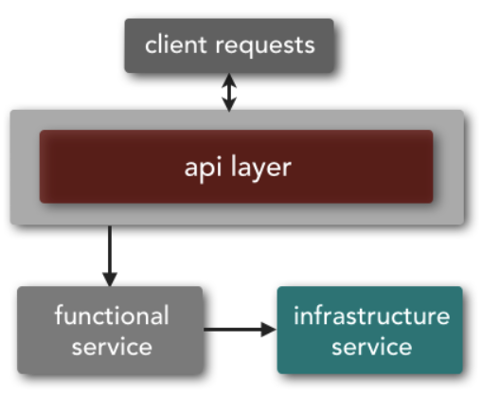
Microservices topology
Functional services
support specific business operations or functions
accessed externally and are generally not shared with any other service
Infrastructure services
support nonfunctional tasks such as authentication, authorization, auditing, logging, and monitoring.
not exposed to the outside world but rather are treated as private shared services only available internally to other services

Slide 39
Granularity
SOA – [small application services; very large enterprise services]
Ex. enterprise Customer service handles update and retrieval data views, delegating the lower-level getters and setters to application-level services that were not exposed remotely to the enterprise
Microservices - single-purpose services that do one thing really, really well
Ex. fine-grained getter and setter services like GetCustomerAddress, GetCustomerName, UpdateCustomerName

Slide 40
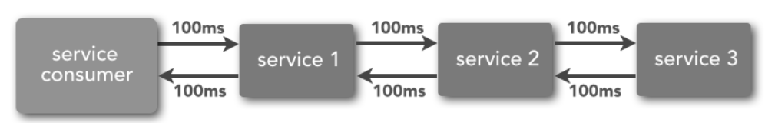
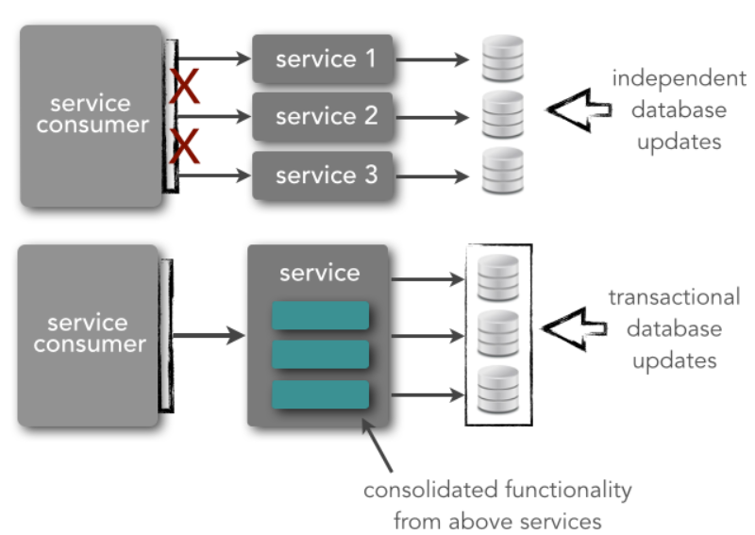
Impact of granularity
Performance
Transaction
management

Slide 41
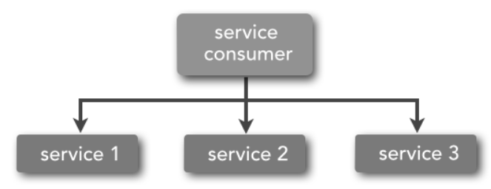
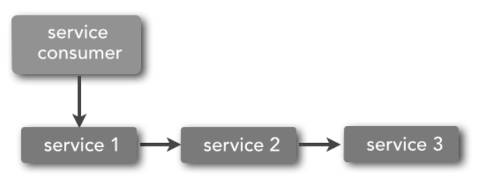
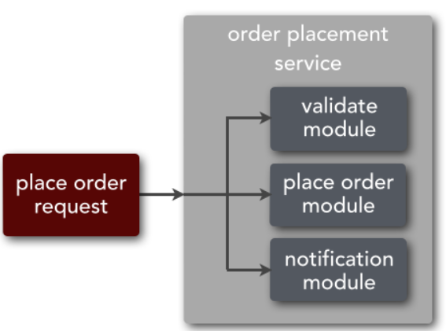
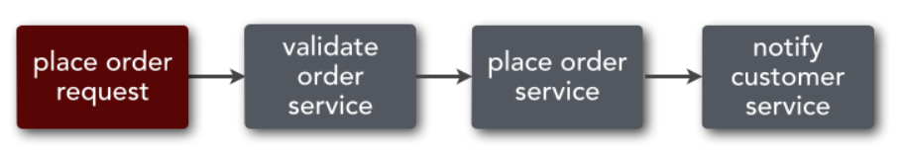
Orchestration and Choreography

Slide 42
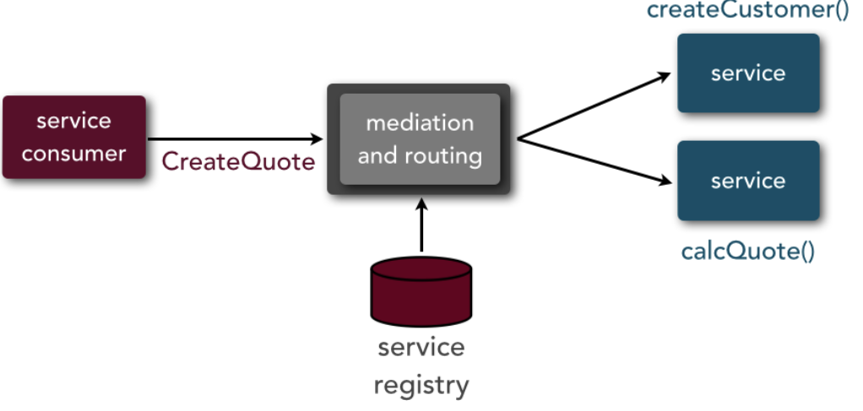
SOA Middleware
Mediation and routing - locate and invoke a service (or services) based on a specific business or user request

Slide 43
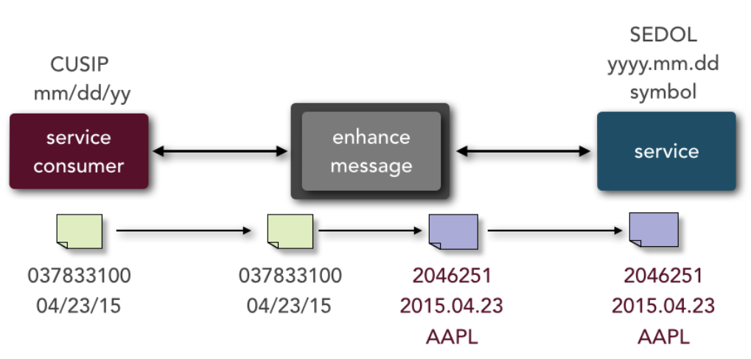
Message enhancement - modify, remove, or augment the data portion of a request before it reaches the service.
Ex. changing a date format, adding additional derived or calculated values to the request, and performing a database lookup to transform one value into another

Slide 44
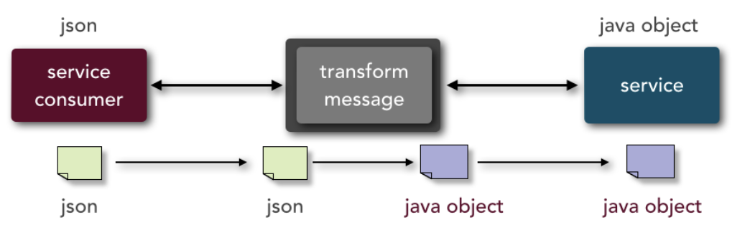
Message transformation - modify the format of the data from one type to other.
Ex. the service consumer is calling a service and sending the data in JSON format, whereas the service requires a Java object

Slide 45
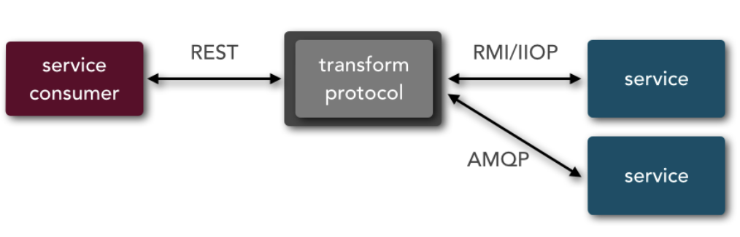
Protocol transformation - have a service consumer call a service with a protocol that differs from what the service is expecting.
Ex. the service consumer is communicating through REST, but the services invoked require an RMI/IIOP connection (e.g., Enterprise JavaBeans 3 [EJB3] bean) and an AMQP connection.

Slide 46
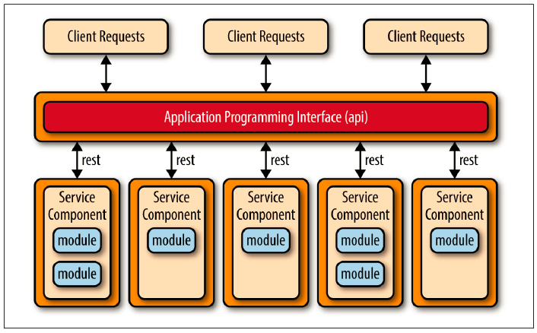
Microservices “API” layer
API REST-based topology - websites that expose small, self-contained individual services through some sort of API

Slide 47
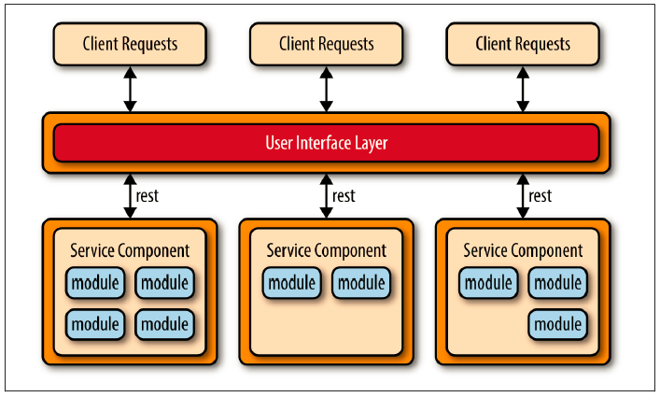
Application REST-based topology – the client requests are received through traditional web-based or fat-client business application screens rather than through a simple API layer
The service components tend to be larger, more coarse-grained, and represent a small portion of the overall business application rather than fine-grained, single-action services.

Slide 48
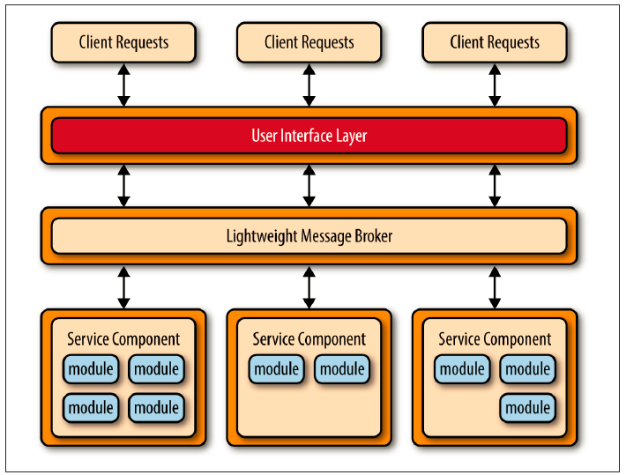
Centralized messaging topology - similar to the previous application REST based topology except that instead of using REST for remote access, it uses a lightweight centralized message broker (e.g., ActiveMQ, HornetQ, etc.).
No orchestration, transformation, or complex routing!
advanced queuing mechanisms, asynchronous messaging, monitoring, error handling, and better overall load balancing and scalability

Slide 49
SOA vs. Microservices
share-as-much-as-possible
uses orchestration and choreography
Uses Message middleware
Coarse-grained services
no pre-described limits as to which remote-access protocols can be used
share-as-little-as-possible
favorizes choreography
Uses API layer as service access façade
Fine-grained services
rely on 2 different remote-access protocols to access services: REST and simple messaging (JMS, MSMQ, AMQP, etc.)

Slide 50
Considerations
Non functional req. | Rating
Overall agility | High
Ease of deployment | High
Testability | High
Performance | Low
Scalability | High
Ease of development | High
Microservices
more robust,
provide better scalability,
supports continuous delivery
real-time production deployments
Yet still…
difficult contract creation, maintenance, and government,
remote system availability,
remote access authentication and authorization

Slide 51
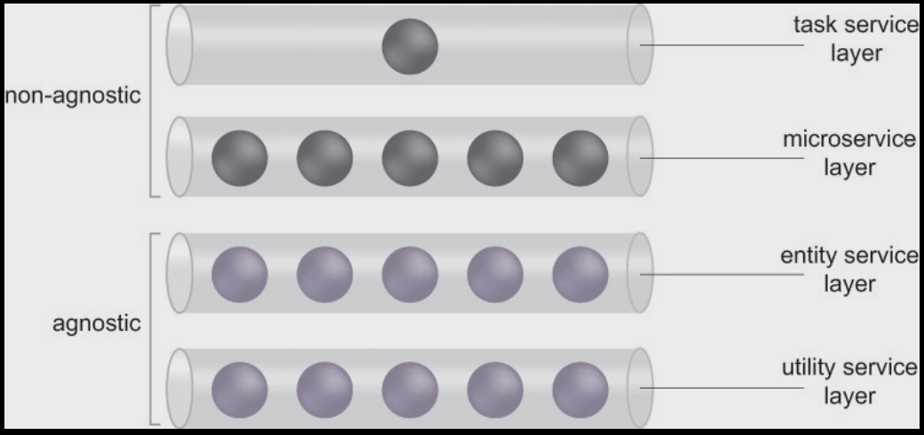
Service layers

Slide 52
Service models
Task Service
a non-agnostic functional context
single-purpose, parent business process logic.
encapsulates the composition logic required to compose several other services to complete its task.
Microservice
a non-agnostic service
small functional scope
logic with specific processing and implementation requirements.
typically not reusable but can have intra-solution reuse potential.
The nature of the logic may vary.

Slide 53
Service models
Entity Service
a reusable service with an agnostic functional context
associated with one or more related business entities (such as invoice, customer, or claim).
Utility Service
a reusable service with an agnostic functional context as well,
not derived from business analysis specifications and models.
encapsulates low-level technology-centric functions, such as notification, logging, and security processing.

Slide 54
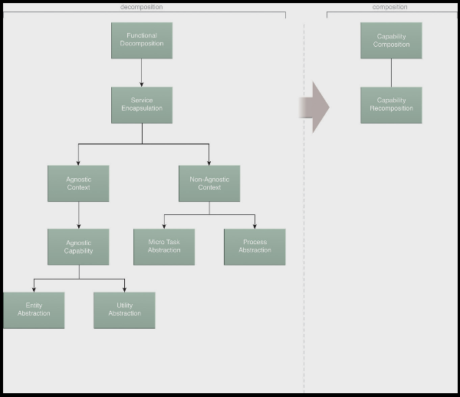
Service Design Process
Break down the
business problem
Service design
Build up the
Service-oriented solution
Solution
Service layers

Slide 55
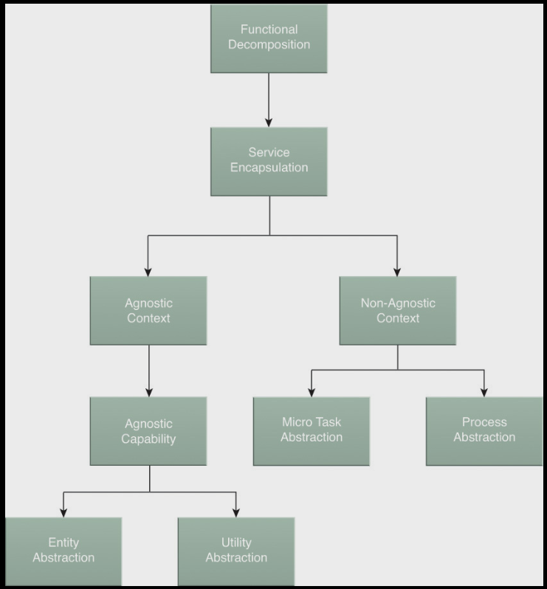
Break down the business problem

Slide 56

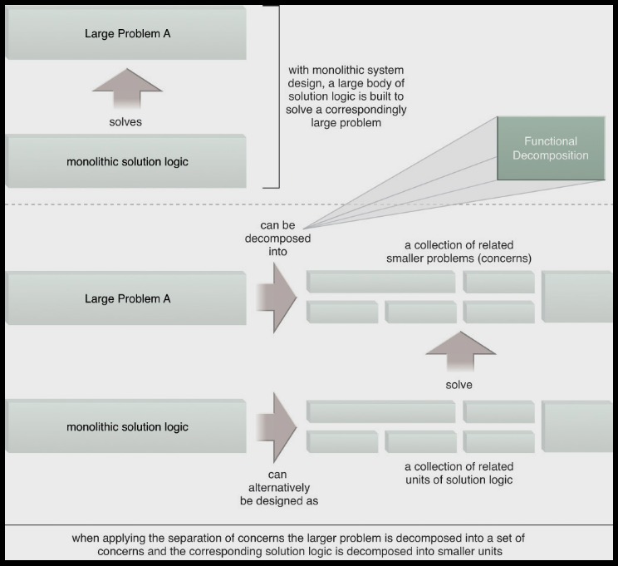
Functional Decomposition – separation of concerns

Slide 57
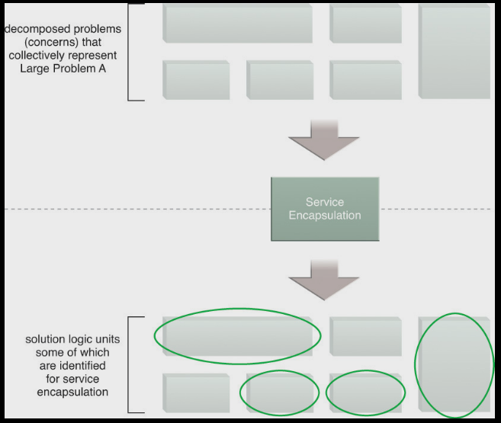
Service Encapsulation

Slide 58
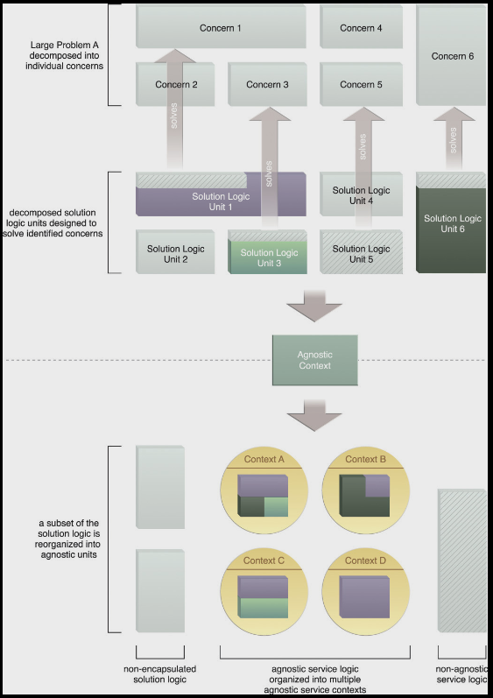
Agnostic context

Slide 59
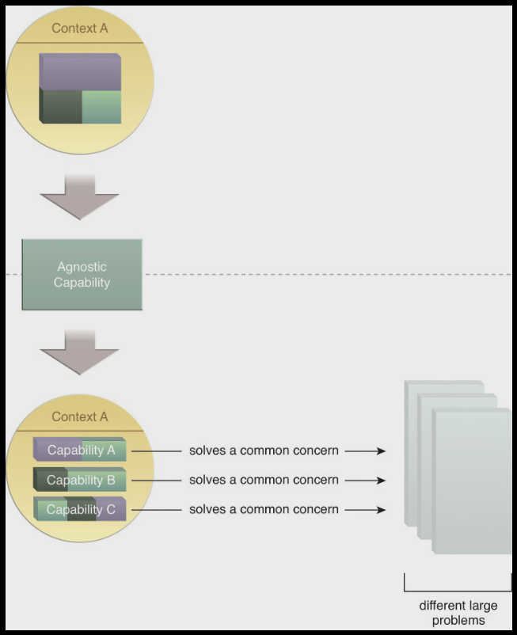
Agnostic capability

Slide 60
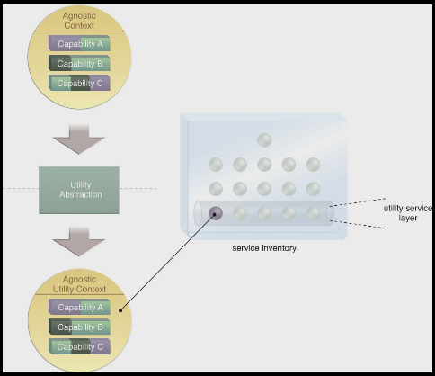
Utility Abstraction

Slide 61
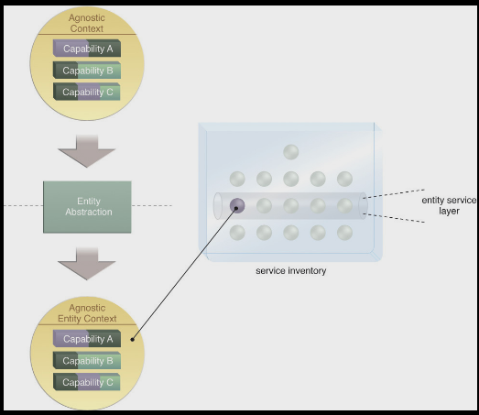
Entity Abstraction

Slide 62
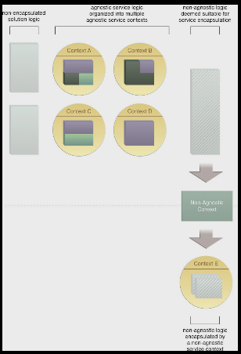
Non-agnostic context

Slide 63
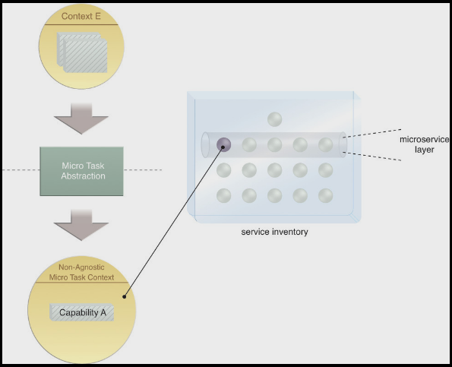
Micro Task abstraction and microservices

Slide 64
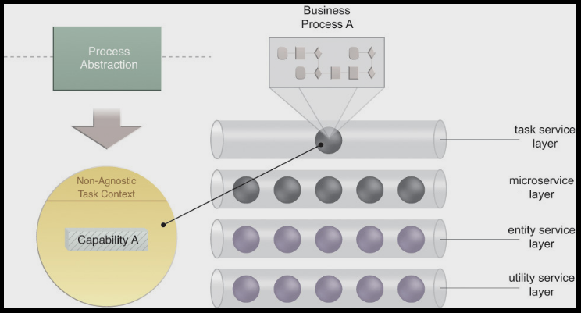
Process abstraction and Task services

Slide 65
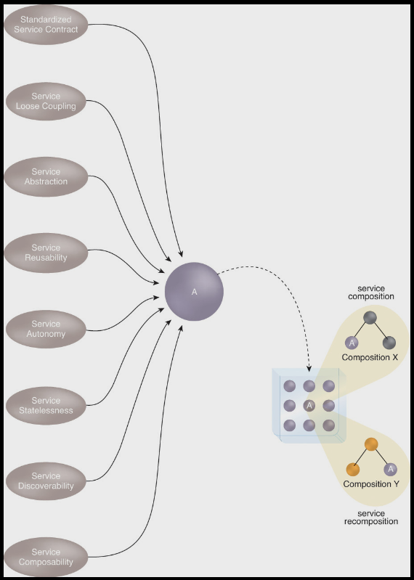
Building up the service-based solution

Slide 66
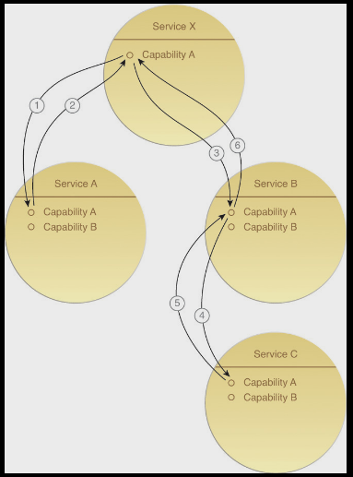
Capability composition
Candidate service capabilities are sequenced together in order to assemble the decomposed service logic into a specific service composition that is capable of solving a specific larger problem
Much of the logic that determines which service capabilities to invoke and in which order they are to be composed will usually reside within the task service.

Slide 67
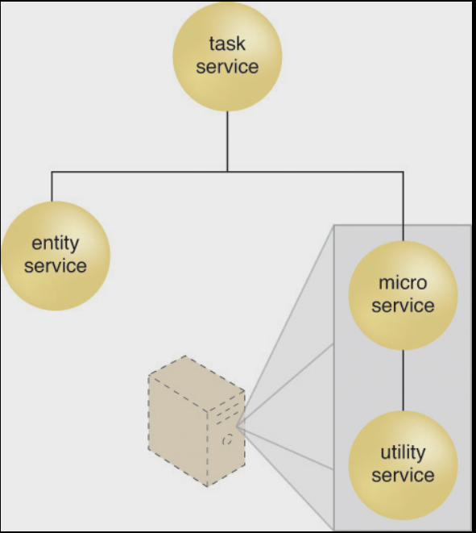
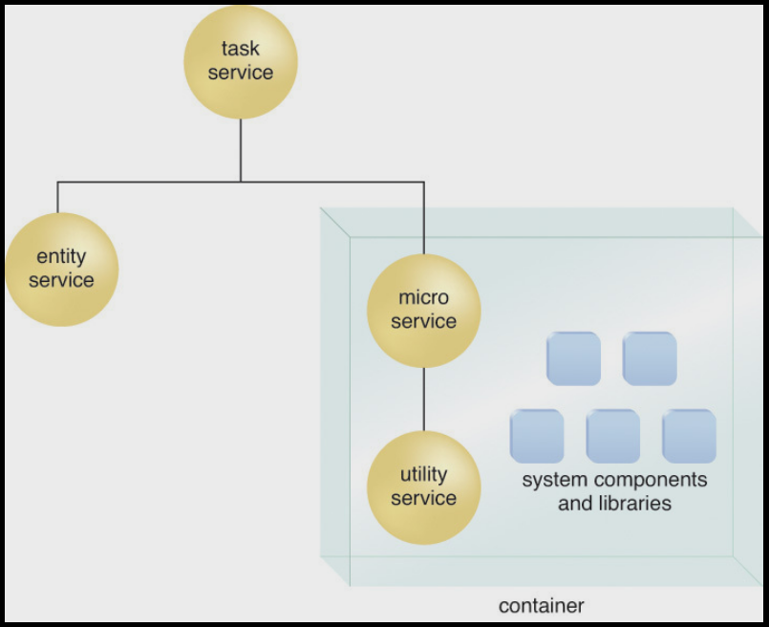
Capability composition and microservices

Slide 68
Variations
Services packaged in the same deployment bundle may be able to communicate in-process or out-of-process.
The microservice in the preceding scenarios may compose the utility service to access an underlying resource or it may disregard the Service Loose Coupling principle and access the underlying resource directly.
Multiple deployment bundles can be located on the same virtual server, as long as respective autonomy requirements can be fulfilled.
In previous Figure, the container is located on a physical server, but it can also be located on a virtual server.
A container can host multiple deployment bundles, which may be desirable if communication between services and resources in the respective bundles is required.

Slide 69
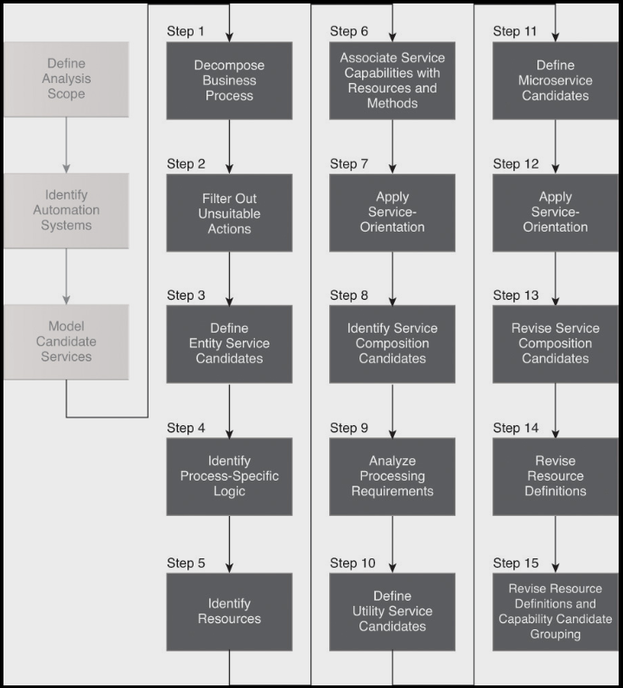
REST service modeling process

Slide 70
Case study – Midwest University Assoc. (MUA)
decided to re-engineer several IT systems to a service-oriented architecture that will preserve legacy assets, simplify integration between various internal and external systems, and improve channel experience for both the students and staff.
The team begins with a REST service modeling process for the Student Achievement Award Conferral business process.
The business process logic represents the procedures followed for the assessment, conference, and rejection of individual achievement award applications submitted by students.
An application that is approved results in the conferral of the achievement award and a notification of the conferral to the student. An application that is rejected results in a notification of the rejection to the student.

Slide 71
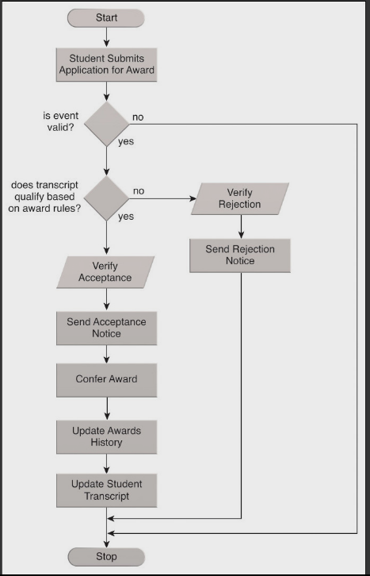

Slide 72
Step 1: Decompose Business Process (into Granular Actions)
Initiate Conferral Application
Get Event Details
Verify Event Details
If Event is Invalid or Ineligible for Award, End Process
Get Award Details
Get Student Transcript
Verify Student Transcript Qualifies for Award Based on Award Conferral Rules
If Student Transcript Does Not Qualify, Initiate Rejection
Manually Verify Rejection
Send Rejection Notice
Manually Verify Acceptance
Send Acceptance Notice
Confer Award
Record Award Conferral in Student Transcript
Record Award Conferral in Awards Database
Print Hard Copy of Award Conferral Record
File Hard Copy of Award Conferral Record

Slide 73
Step 2: Filter out unsuitable actions
Initiate Conferral Application
Get Event Details
Verify Event Details
If Event is Invalid or Ineligible for Award, End Process
Get Award Details
Get Student Transcript
Verify Student Transcript Qualifies for Award Based on Award Conferral Rules
If Student Transcript Does Not Qualify, Initiate Rejection
Manually Verify Rejection
Send Rejection Notice
Manually Verify Acceptance
Send Acceptance Notice
Confer Award
Record Award Conferral in Student Transcript
Record Award Conferral in Awards Database
Print Hard Copy of Award Conferral Record
File Hard Copy of Award Conferral Record

Slide 74
Step 3: Define Entity service candidates
Which service capability candidates defined so far are closely related to each other?
=>group capability candidates based on common functional contexts
Are identified service capability candidates business-centric or utility-centric?
=> the organization of service candidates within logical service layers (entity and utility)
What types of functional service contexts are suitable, given the overarching business context of the service inventory?
=> establish functional service boundaries

Slide 75
Analysis results
NON-AGNOSTIC
Initiate Conferral Application
Get Event Details
Verify Event Details
If Event is Invalid or Ineligible for Award, End Process
Get Award Details
Get Student Transcript
Verify Student Transcript Qualifies for Award Based on Award Conferral Rules
If Student Transcript Does Not Qualify, Initiate Rejection
Send Rejection Notice
Send Acceptance Notice
Record Award Conferral in Student Transcript
Record Award Conferral in Awards Database
Print Hard Copy of Award Conferral Record

Slide 76
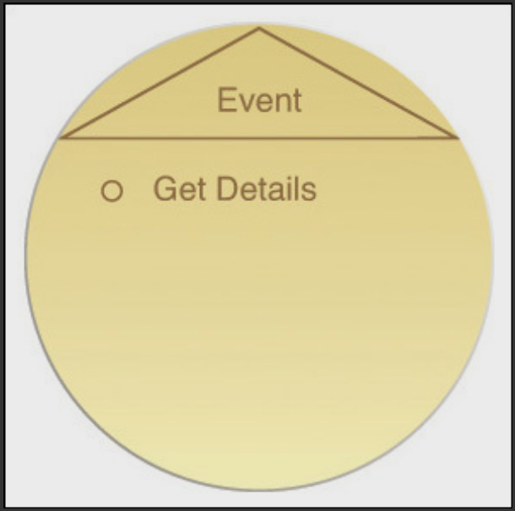
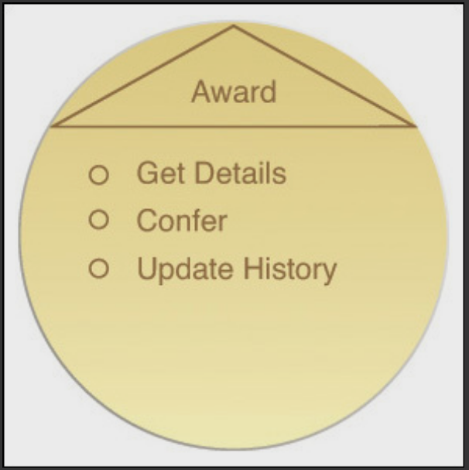
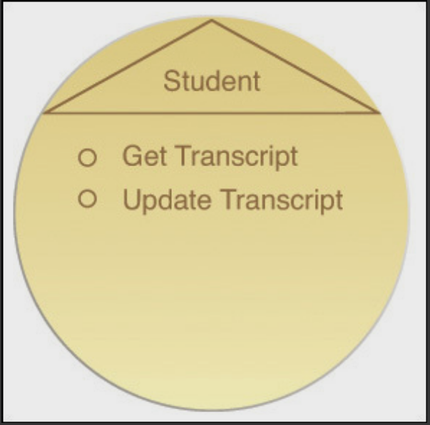
Agnostic actions -> entity service candidates
Get Event Details
Get Award Details
Get Student Transcript
Send Rejection Notice
Send Acceptance Notice
Record Award Conferral in Student Transcript
Record Award Conferral in Awards Database
Print Hard Copy of Award Conferral Record

Slide 77
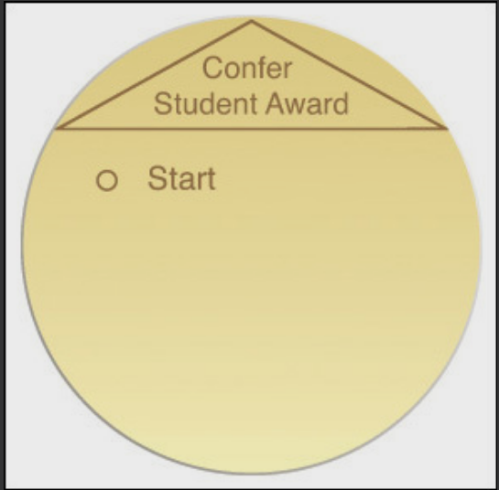
Step 4: identify process-specific logic
Non-agnostic capabilities
Grouped in a task service/consumer service (composition controller)
Initiate Conferral Application
Verify Event Details
If Event is Invalid or Ineligible for Award, End Process
Verify Student Transcript Qualifies for Award Based on Award Conferral Rules
If Student Transcript Does Not Qualify, Initiate Rejection

Slide 78
Step 5: identify resources
Agnostic (multi-purpose)
can be incorporated into agnostic service and capability candidates without limitation.
likely to be shared and reused more frequently
Non-agnostic (single-purpose)
Case-study
/Process/ -> /Student Award Conferral Process/
/Application/ -> /Conferral Application/
/Event/
/Award/
/Student Transcript/
/Notice Sender/
/Printer/

Slide 79
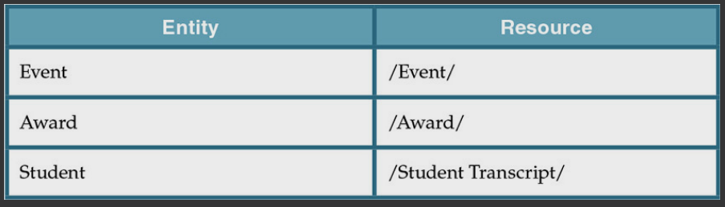
Resource mapping

Slide 80
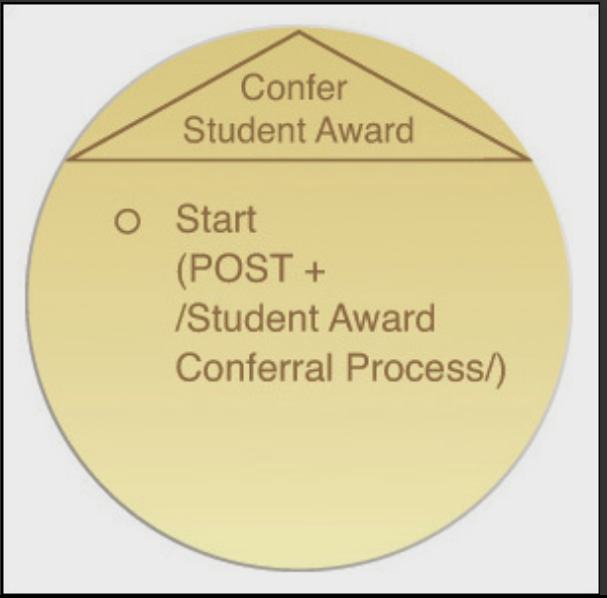
Step 6: Associate Service Capabilities with Resources and Methods
Confer Student Award Service Candidate (Task)
/Application/ resource
POST method to forward the application to a resource named after the business process itself

Slide 81
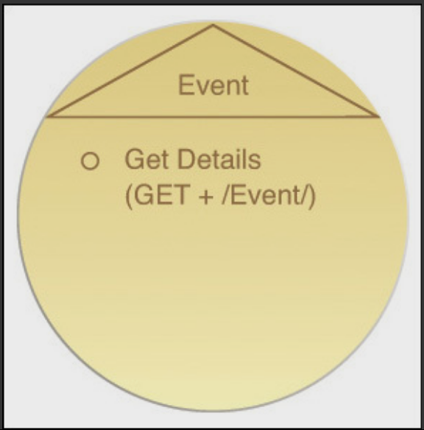
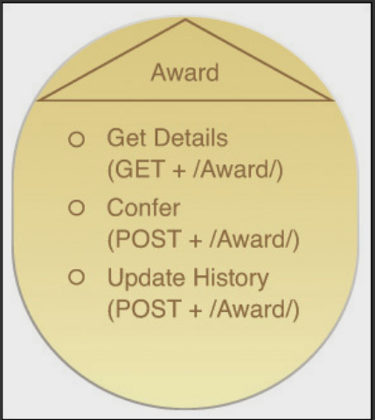
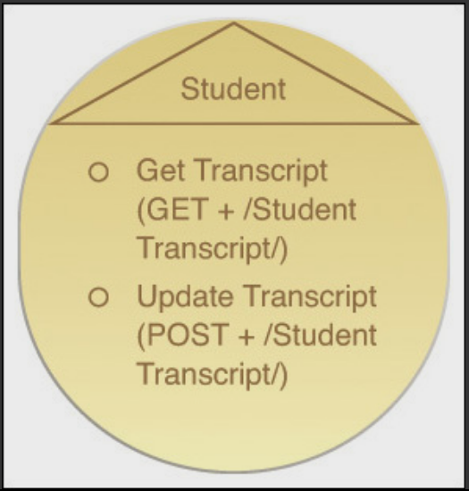
Event service candidate (Entity)
Award service candidate (Entity)
Student service candidate (Entity)

Slide 82
Step 7: Apply service orientation
Ex. a given set of resources is related to data provided by a large legacy system => impacts functional service boundaries by the extent to which the Service Autonomy (297) principle can be applied.

Slide 83
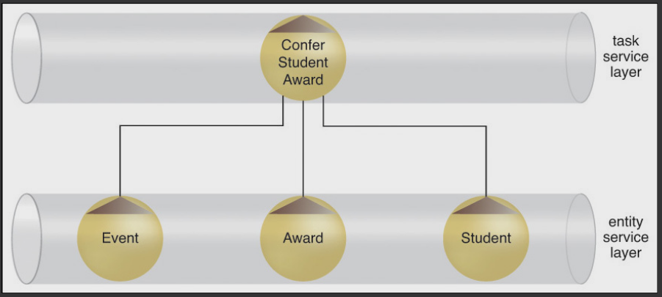
Step 8: identify service composition candidates
Identify most common service capability interactions based on success and failure scenarios

Slide 84
Step 9: Analyze processing requirements
Which of the resources identified so far can be considered utility-centric?
Can actions performed on business-centric resources be considered utility-centric (such as reporting actions)?
What underlying application logic needs to be executed in order to process the actions and/or resources encompassed by a service capability candidate?
Does any required application logic already exist?
Does any required application logic span application boundaries? (In other words, is more than one system required to complete the action?)

Slide 85
Case Study
Utility centric functions
Send Rejection Notice
Send Acceptance Notice
Print Hard Copy of Award Conferral Record
Utility centric resources
/Notice Sender/
/Printer/
External Processes
Rules utility service (usually overloaded)
=> Verify Student Transcript Qualifies for Award Based on Award Conferral Rules -> microservice

Slide 86
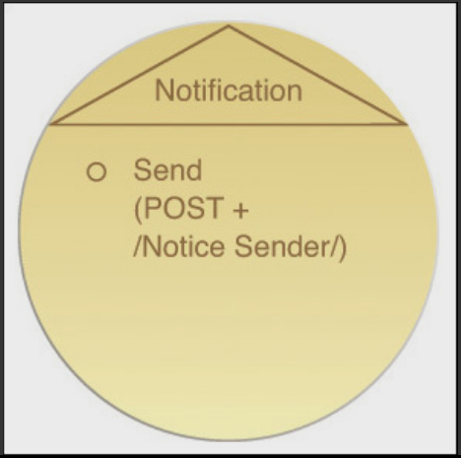
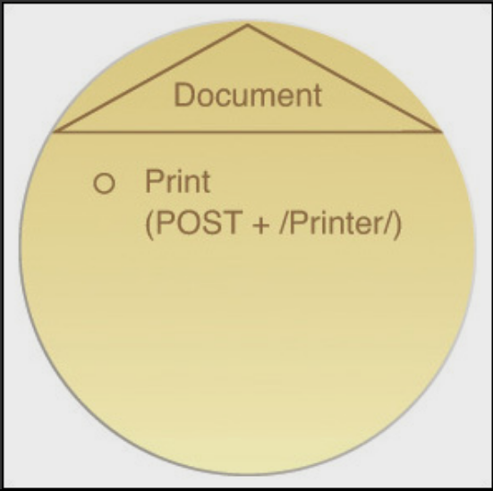
Step 10: Define Utility Service Candidates (and Associate Resources and Methods)
group utility-centric processing steps according to pre-defined contexts.
Association with a specific legacy system
Association with one or more solution components
Logical grouping according to type of function
Notification Service candidate
Send Rejection Notice
Send Acceptance Notice
/Notice sender/
Document service candidate
Print Hard Copy of Award Conferral Record
/Printer/

Slide 87

Step 11: Define Microservice Candidates (and Associate Resources and Methods)
introduce a highly independent and autonomous service implementation architecture that can be suitable for units of logic with particular processing demands.
considerations can include:
Increased autonomy requirements
Specific runtime performance requirements
Specific runtime reliability or failover requirements
Specific service versioning and deployment requirements

Slide 88

Step 12: Apply service-orientation
Step 13: Revise candidate service compositions

Slide 89
Wrap-up
Service oriented concepts
Detailed step-by-step process for modeling REST service candidates.
Extended SOA patterns catalog at http://soapatterns.org

